Slide 1

TEXT CLASSIFICATION BASED BEHAVIOURAL ANALYSIS OF WHATSAPP CHATS.
SIDDHARTHA INSTITUTE OF TECHNOLOGY & SCIENCES
Computer Science Engineering (Data Science)
MINI PROJECT
BATCH -1
M.RAMYA SRI(20TQ1A6709)
J.GAYATHRI(20TQ1A6717)
CH.ROOPA(20TQ1A6725)
E.NISHANTH REDDY(20TQ1A6704)
GUIDE NAME
DR.A.SATYANARAYANA
Professor-DEPT OF CSE

Slide 2
CONTENT
INTRODUCTION
ABSTRACT
LITERATURE SURVEY
OBJECTIVES
ARCHITECTURE
SYSTEM DESIGN(DATAFLOW)
USE CASE,SEQUENCE DIAGRAMS
FLOWCHART
SOFTWARE REQUIREMENTS
UML DIAGRAM
SAMPLE CODE &SCREENSHOTS
CONCLUSION
FUTURESCOPE
REFERENCES

Slide 3
ABSTRACT
The ubiquity of digital communication platforms has revolutionized interpersonal interactions, with WhatsApp serving as a prominent example. This project delves into a comprehensive analysis of WhatsApp chat data, unraveling valuable insights by focusing on media usage, message frequency, temporal dynamics, participant engagement, and linguistic expression through words and emojis.
The project initiates by securely collecting and preparing WhatsApp chat data, ensuring data integrity and privacy.
project seeks to provide actionable insights across diverse domains. Community managers can optimize engagement by understanding activity patterns, while researchers gain a nuanced understanding of communication dynamics. Individuals gain self-awareness of their communication habits, and businesses can adapt strategies by recognizing prevalent themes and sentiment.

Slide 4
INTRODUCTION
In an era where digital communication has become an integral part of our lives, messaging platforms like WhatsApp have revolutionized the way we connect and interact. The prevalence of these platforms has generated a vast repository of conversational data, holding valuable insights into communication dynamics, user behaviors, and societal trends. This project embarks on a comprehensive exploration of WhatsApp chat data, focusing on several key dimensions, including media usage, message frequency, temporal patterns, participant engagement, and linguistic expressions through words and emojis.
The central aim of this project is to uncover hidden patterns and nuances within WhatsApp conversations, shedding light on how individuals engage, express emotions, and shape their interactions through various modalities. By delving into the multifaceted nature of these conversations, we gain a deeper understanding of the digital human experience and the intricate ways in which technology influences our communication behaviors.

Slide 5
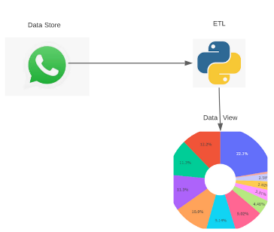
The project methodology entails a meticulous process of data collection and preparation, ensuring the privacy and confidentiality of the participants. With the foundation laid, we delve into the following dimensions:
1.Media Usage Analysis
2.Message Frequency and Temporal Patterns
3.Participant Engagement and Most Frequent User
4.Heatmap Visualization of Activity
5.Most Frequent Words and Emojis
6.Emoji Analysis
7.Sentiment Analysis

Slide 6
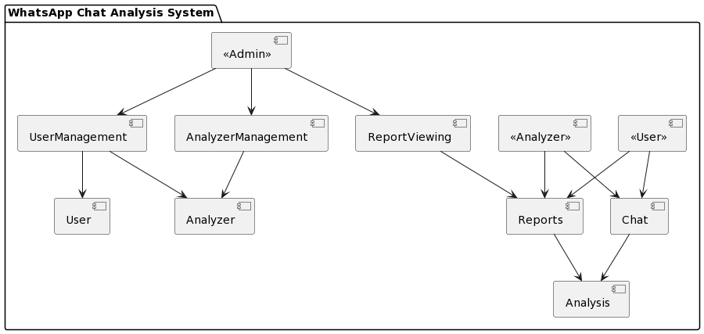

Slide 7
LITERATURE SURVEY
A comprehensive literature survey for the WhatsApp chat analysis project, focusing on pattern recognition and behavioural insights, using Natural Language Processing (NLP) techniques, would involve exploring research and studies related to digital communication analysis, social network analysis, and behavioural pattern recognition. Here is a summarized literature survey that highlights key findings and contributions relevant to the project:
"Emoticon Style: Interpreting Differences in Emoticons Across Cultures" by Miller (2016) explored cultural variations in emoticon usage, emphasizing how visual elements like emojis contribute to conveying emotions and reactions in digital communication.
"Patterns of Text and Word Pair Frequencies in Written Discourse" by Zipf (1935) introduced Zipf's law, which describes the frequency distribution of words in text. This concept can be extended to analyse message frequency patterns in WhatsApp chats.
"Analysing Participant Roles in an Online Community" by Preece and Ghozati (2001) discussed the identification of participant roles in online communities, providing a framework to understand how different users contribute to discussions.

Slide 8


"An Analysis of Emojis Usage and Its Relation to Emotional Context in WhatsApp Communication" by Vidhate et al. (2019) investigated the relationship between emojis and emotional context in WhatsApp chats, shedding light on the role of emojis in communication.
"Visual Analysis of Social Media Data" by Luo et al. (2017) discussed visualization techniques for social media data, including heatmaps, which can be applied to represent message activity and participant interactions in WhatsApp chats.
"Emoji Sentiment Ranking: A Practitioner's Guide" by Novak, P., Smailović, J., Sluban, B., & Mozetič, I.
This literature survey provides a foundation for understanding and analysing various aspects of the WhatsApp chat analysis project, including media usage, message frequency, temporal dynamics, participant behaviour, word and emoji usage, and visualization techniques for representing communication patterns.

Slide 9
OBJECTIVE
The objective of the WhatsApp chat analysis project is to develop a comprehensive and user-friendly system that allows users to analyze WhatsApp chat data. This project aims to provide valuable insights and information from WhatsApp conversations, ultimately enhancing the understanding of chat dynamics and improving communication.

Slide 10
Existing System
In olden days’ there is no analysis for WhatsApp chat. If someone wants to analyze there is no CSV file to analyze. WhatsApp Application provide export txt file which is in raw format. It is very complicated for analysis.
Disadvantages of Existing System
Raw data.
Time consuming.
Difficult to Analyze.
Analysis are not accurate.

Slide 11
PROPOSED SYSTEM
The “WhatsApp Chat Analyzer” provides a platform to the user which enables user to analyze WhatsApp chats online. This application allows user to browse WhatsApp exported (.txt) file and import it to WhatsApp chat analyzer and get analysis according to that txt file. And user can Analyze by clicking Show Analysis button.
Advantages of WhatsApp Chat Analyzer:
• Runs on all devices.
• Most busy users.
• Most used words
• Emoji analysis, Sentiment Analysis.
• Shows based on WhatsApp chat file.
• Shows different visualizations.
• Total Messages.
• Total words.
• Media shared.
• Link shared.
• Monthly timeline, Weekly activity.
• Most busy day.

Slide 12
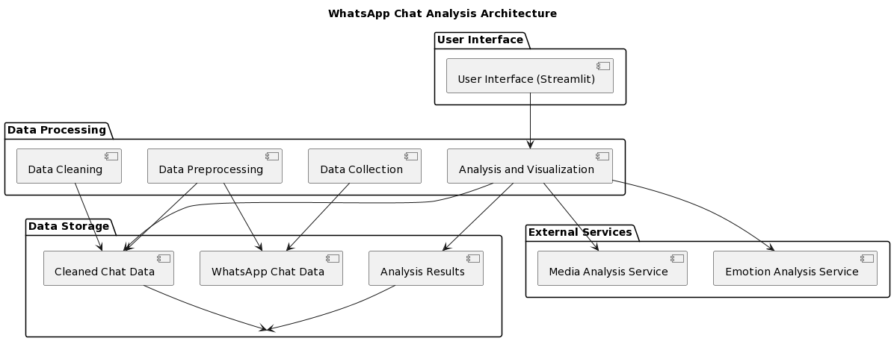
ARCHITECTURE

Slide 13
SYSTEM DESIGN
Data flow Diagram:
A data flow diagram shows the way information flows through a process or system. It includes data inputs and outputs, data stores, and the various subprocesses the data moves through. DFDs are built using standardized symbols and notation to describe various entities and their relationships. Data flow diagrams visually represent systems and processes that would be hard to describe in a chunk of text.

Slide 14
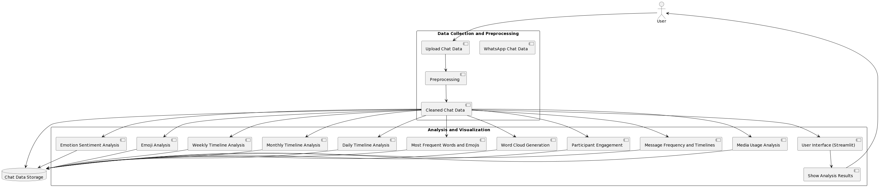
Data flow diagram

Slide 15
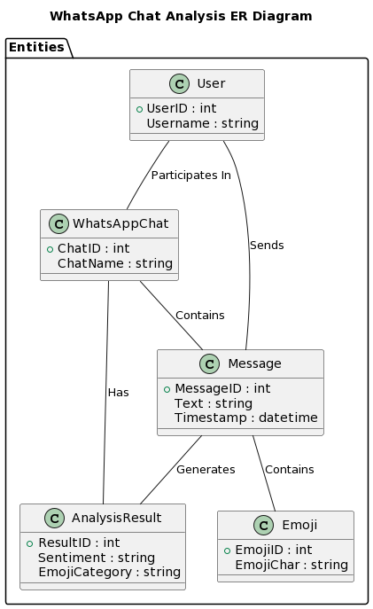
ER diagram

Slide 16
USE CASE DIAGRAM
A Use Case diagram is a graphical depiction of a user's possible interactions with a system. A use case diagram shows various use cases and different types of users the system has and will often be accompanied by other types of diagrams as well. A use case diagram doesn’t describe the order in which the use cases are carried out but the behavior and the interactions between the user and the system.

Slide 17
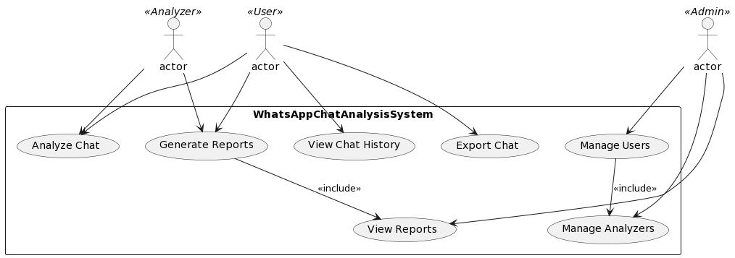
USE CASE DIAGRAM FOR USER INTERFACE

Slide 18
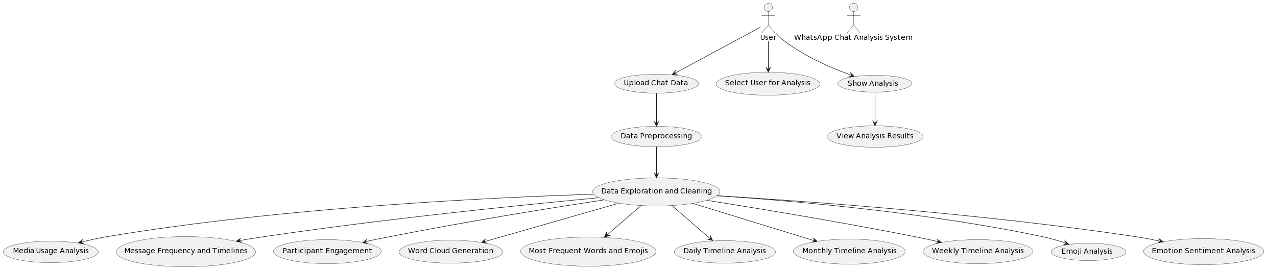
USE CASE DIAGRAM

Slide 19
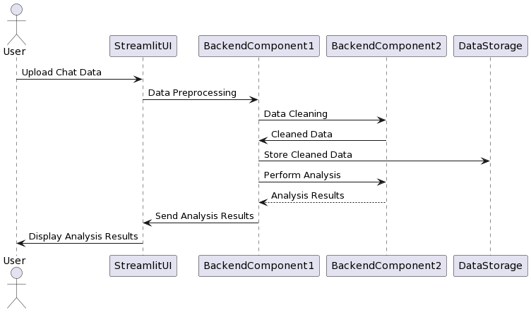
SEQUENCE DIAGRAM
A sequence diagram is a visual representation that illustrates the interactions and order of messages exchanged among objects or components in a system or process. It is commonly used in system design to depict the flow of actions or events over time.

Slide 20
FLOWCHART
It is a type of diagram that represents the flow of process. It can be a pictorial or diagrammatical representation of an algorithm or a system or progression through a procedure. It is represented using multiple conventional symbols and lines that connect the symbols.

Slide 21
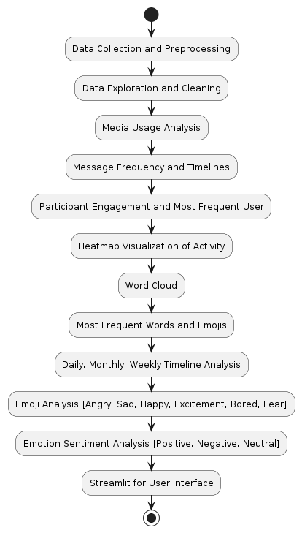
Flowchart:

Slide 22
Software Requirements:
Windows
Python
VS Code
Development Frameworks: Pandas, Matplotlib, Seaborn, NLTK (Natural Language Toolkit), and scikit-learn.
Text Analysis Libraries: natural language processing (NLP), such as TextBlob or spaCy.
Emoji Analysis Tools:Emoji Sentiment or Emoji Python.
Version Control:GitHub or GitLab for collaborative development.
Streamlit (python library for user interface)

Slide 23
Hardware Requirements :
Processor – i3 and above
Hard disk – 5 GB
Memory – 4GB RAM

Slide 24
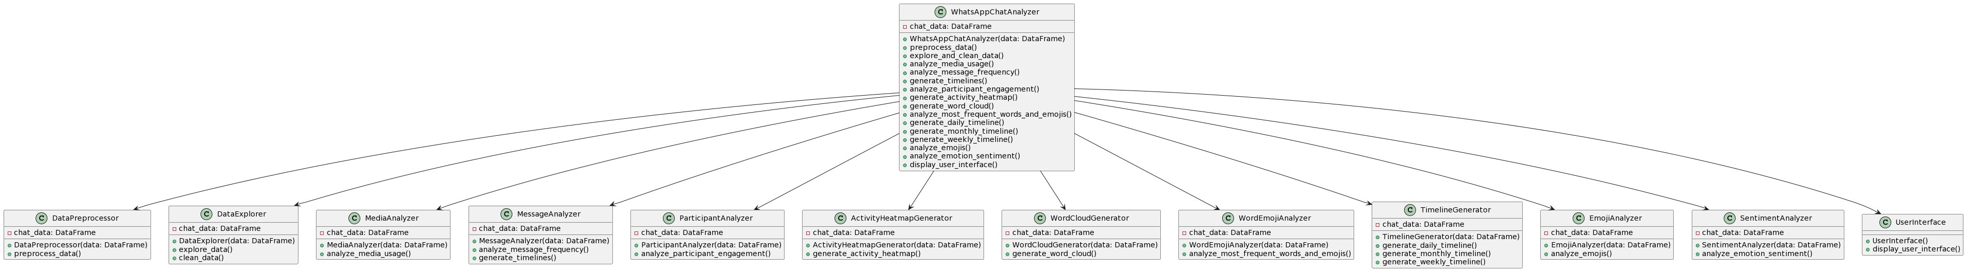
UML DIAGRAM

Slide 25
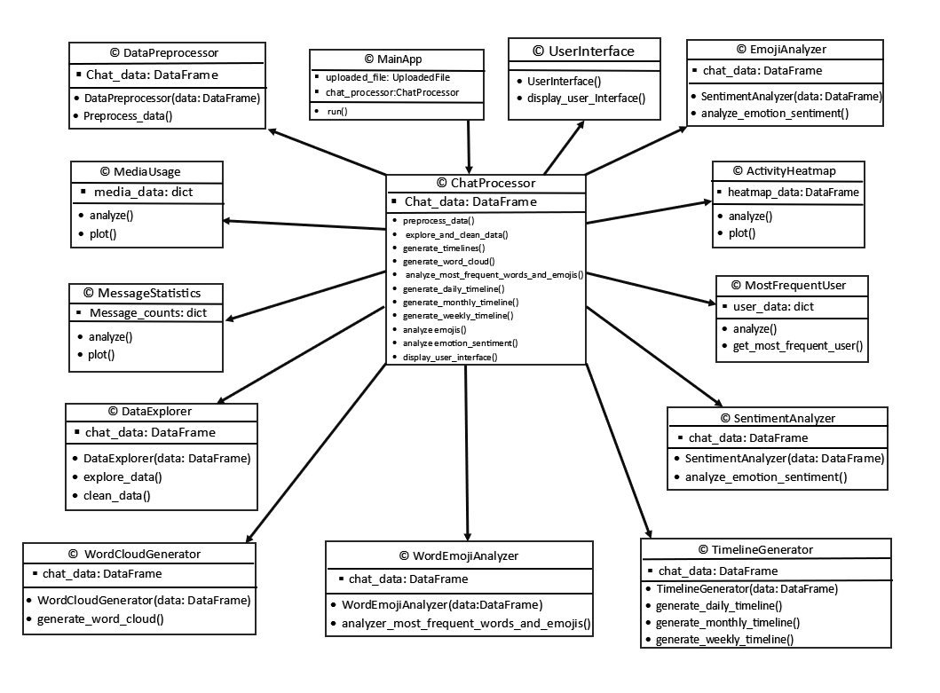
UML DIAGRAM

Slide 26
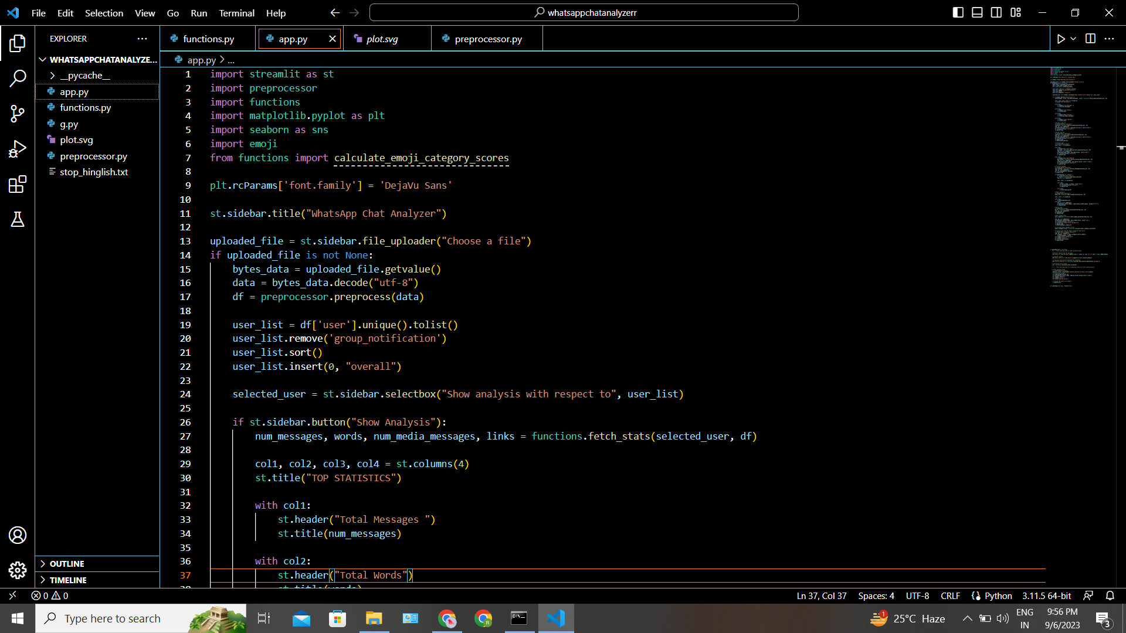
Sample Code :
App.py: This is the main application file responsible for creating a user-friendly web interface using the Streamlit library.

Slide 27
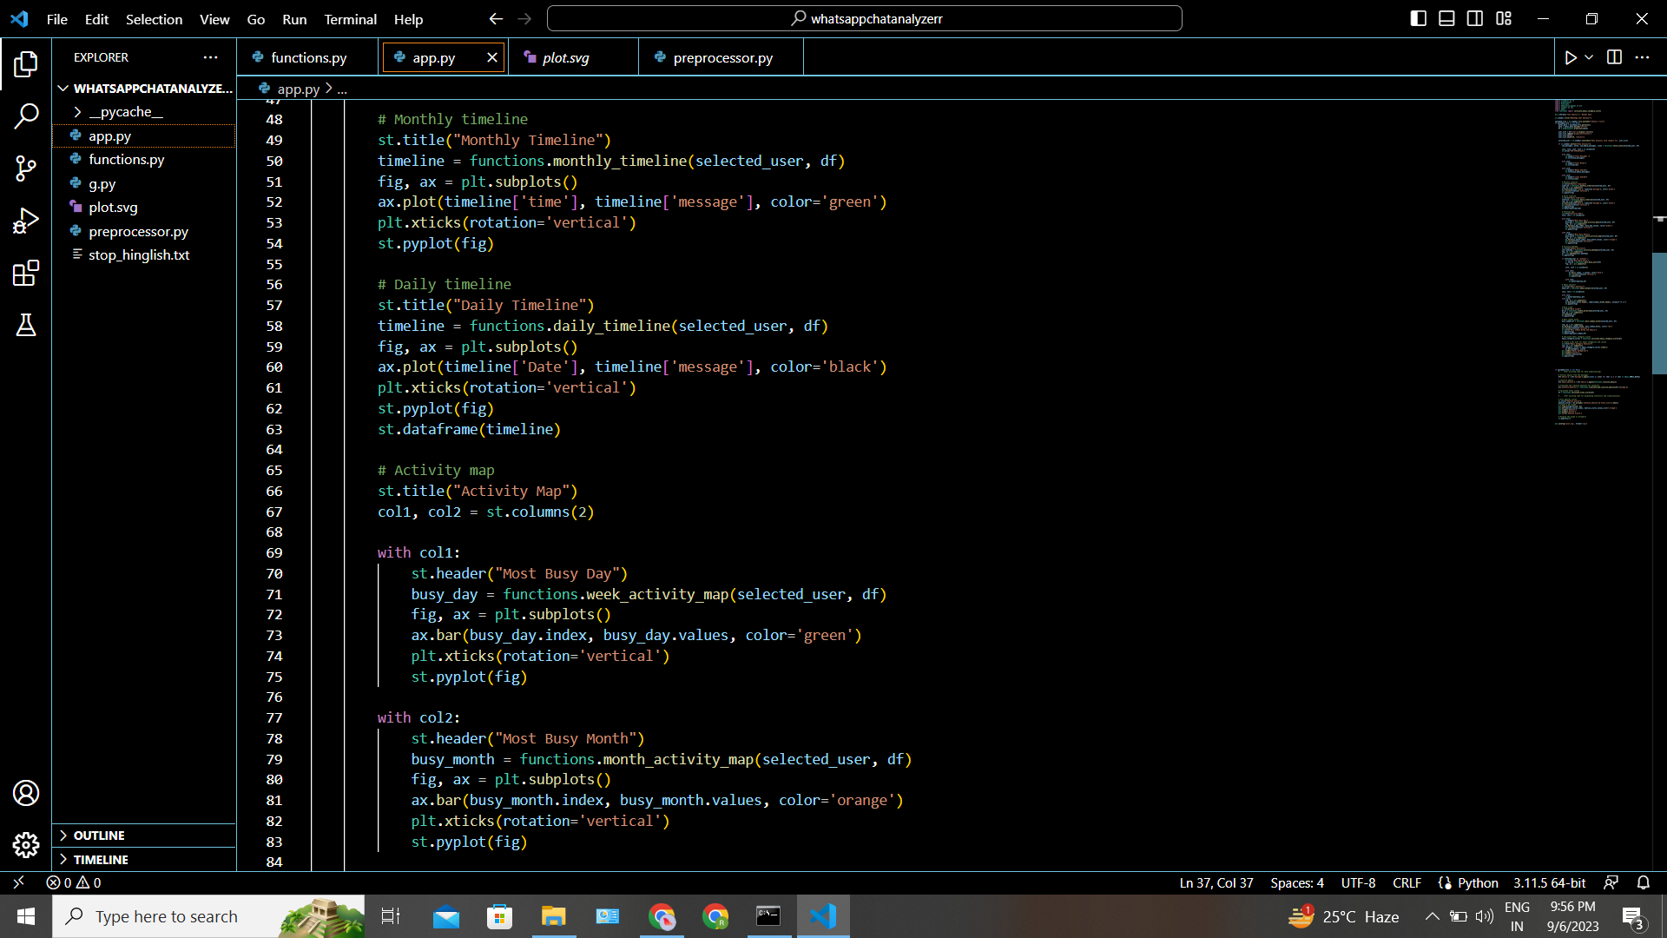

Slide 28
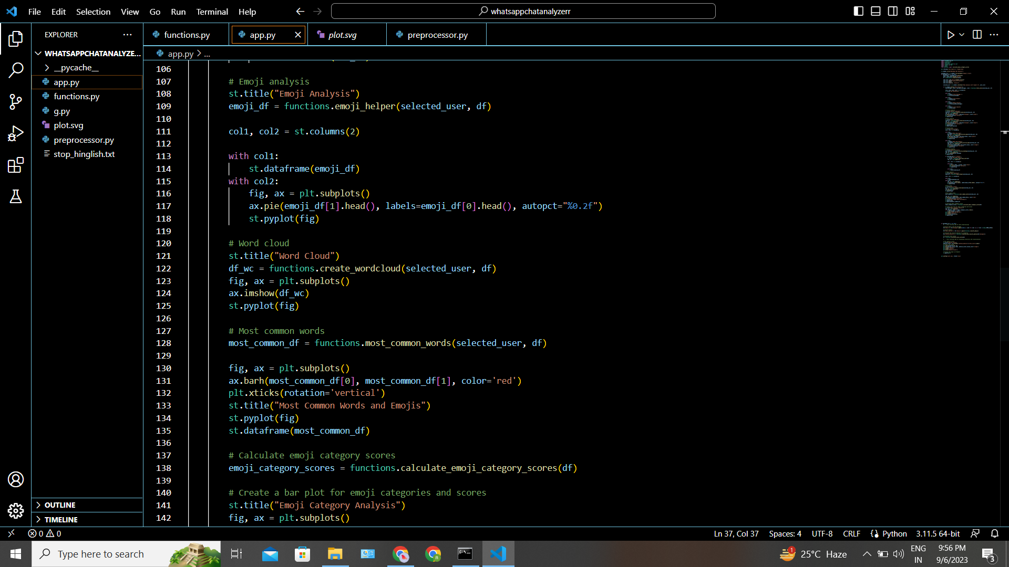

Slide 29
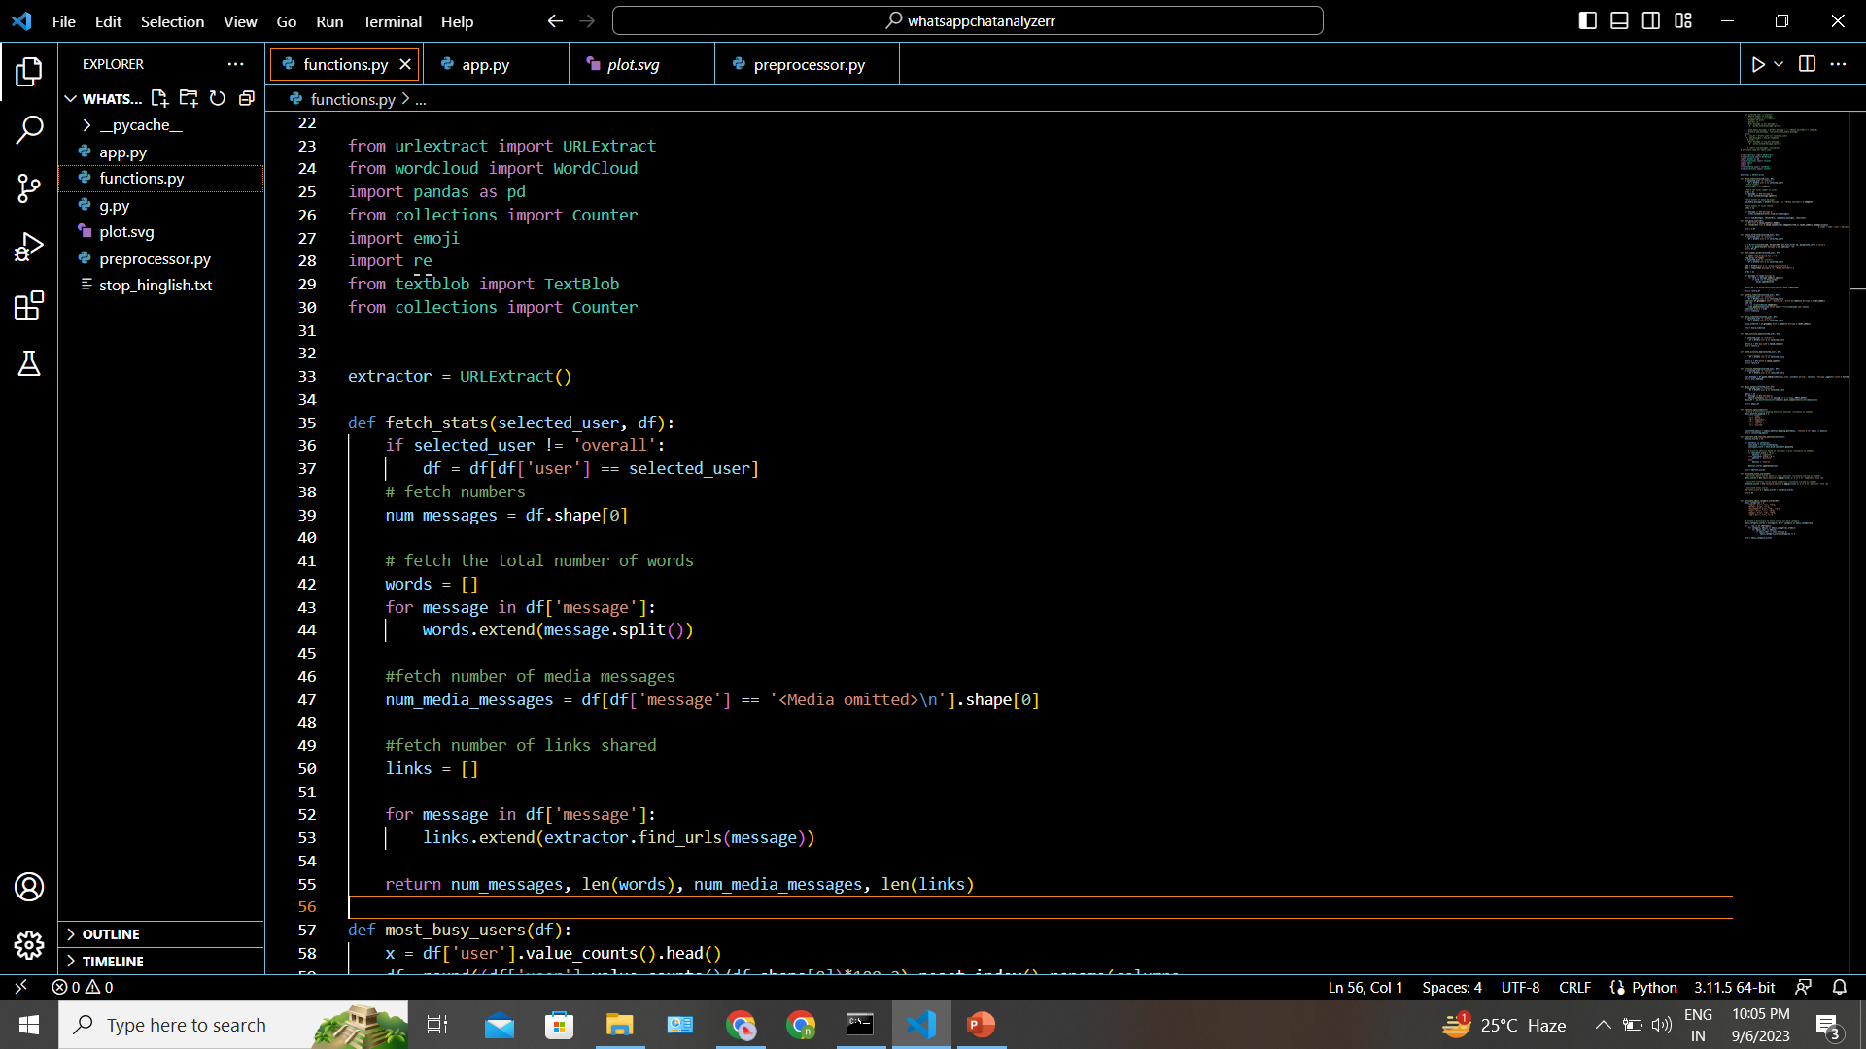
Functions.py: Contains a collection of functions for analyzing and visualizing WhatsApp chat data.

Slide 30
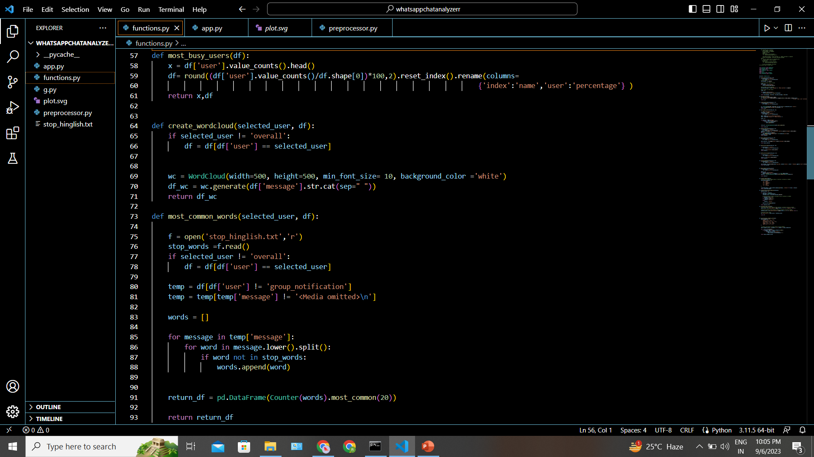

Slide 31
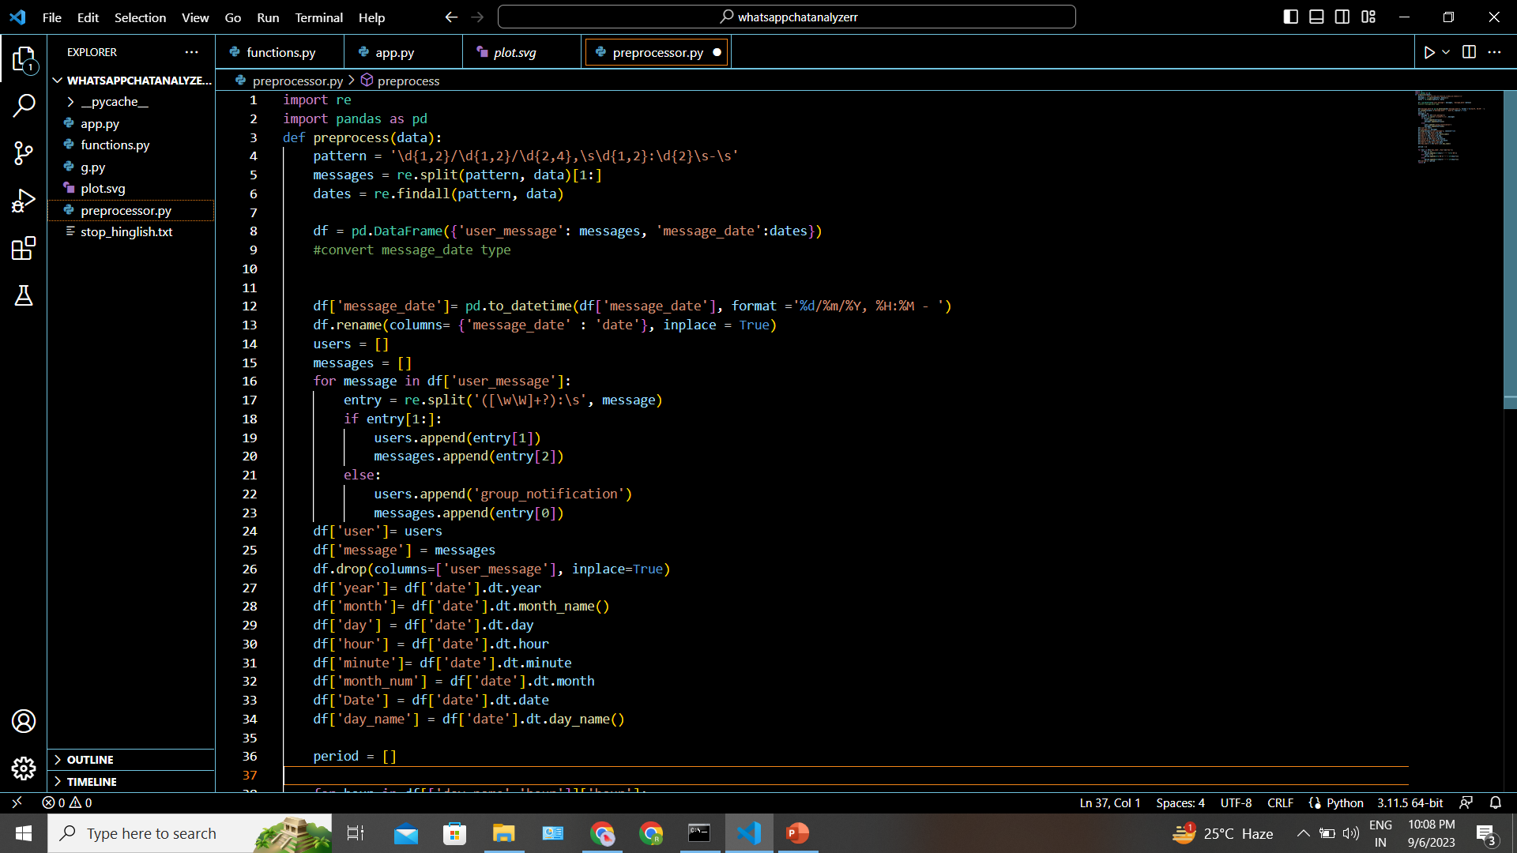
Preprocessor.py:This module preprocesses the raw WhatsApp chat data, making it suitable for analysis.

Slide 32
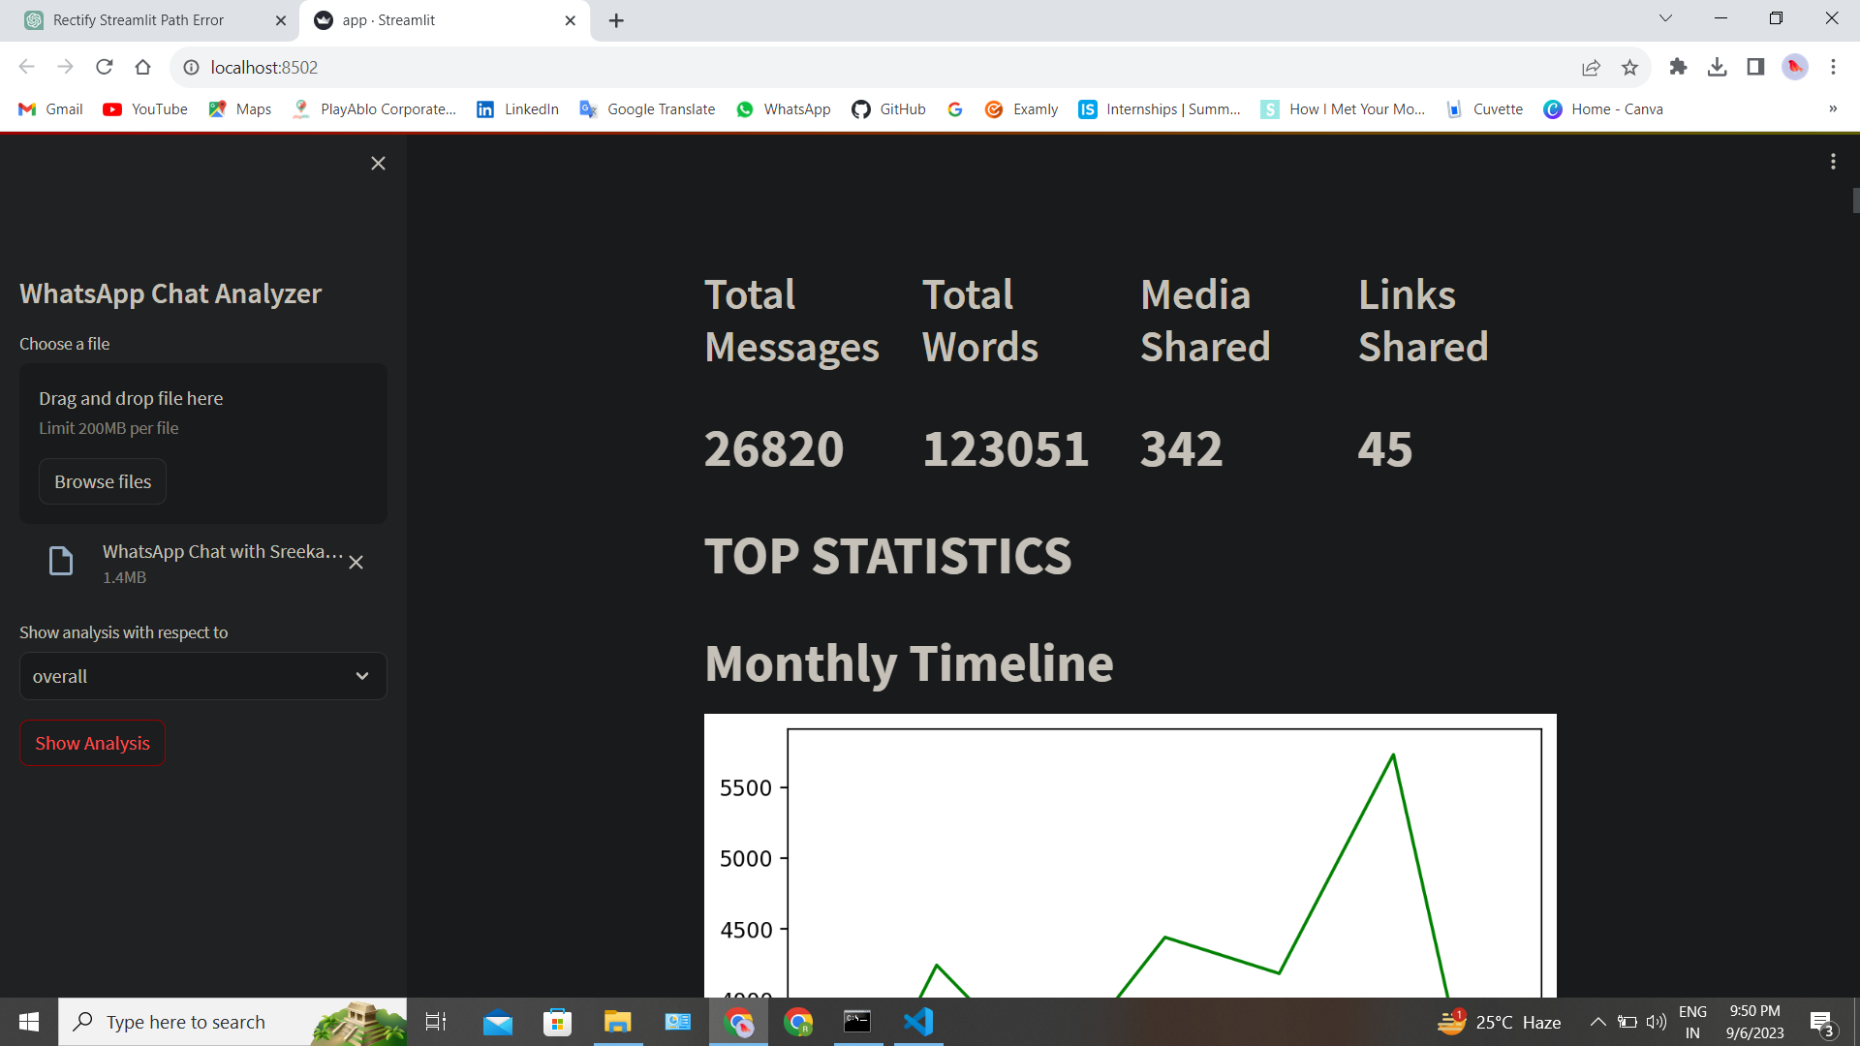
RESULTS:

Slide 33
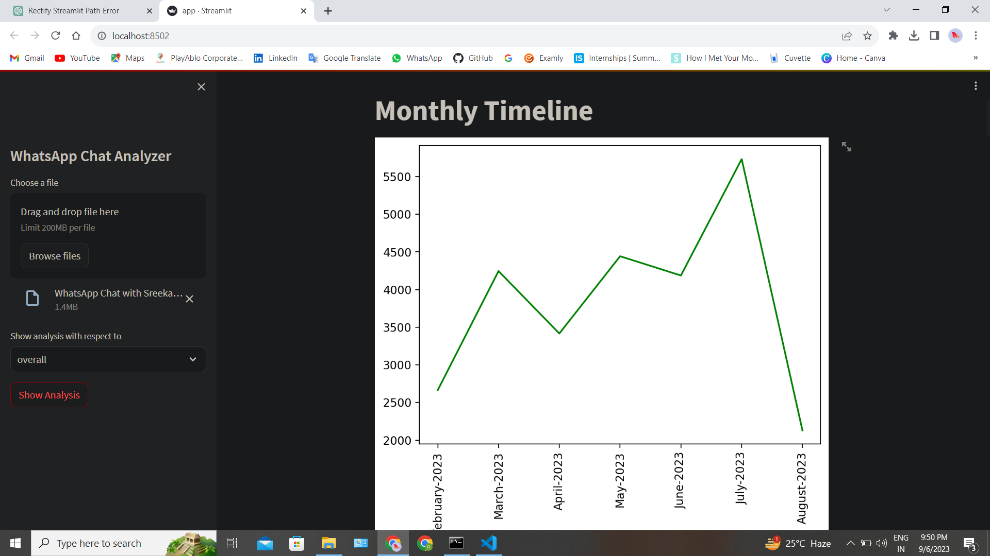

Slide 34
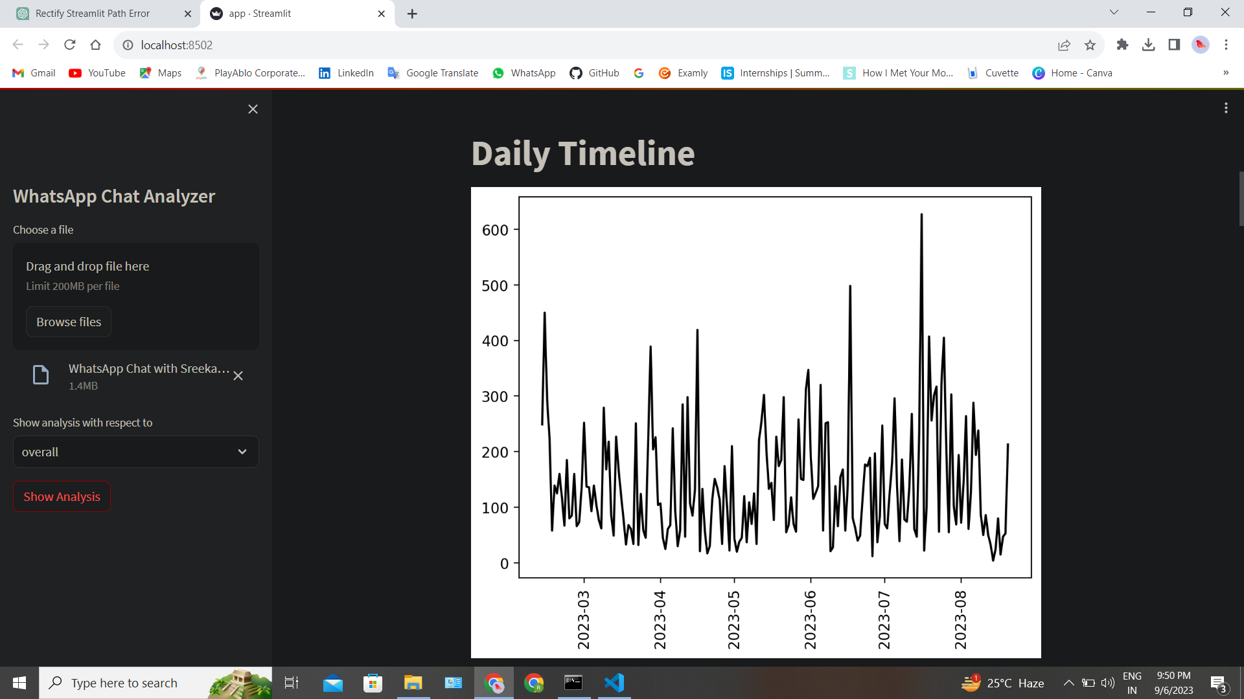

Slide 35
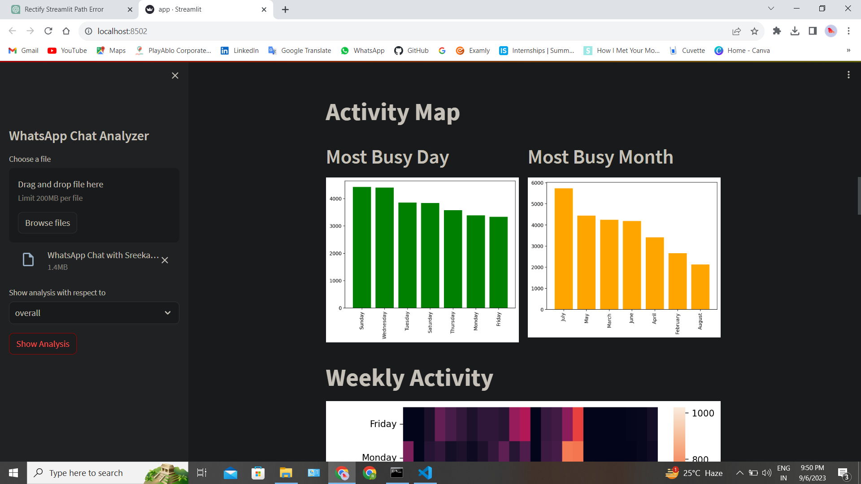

Slide 36
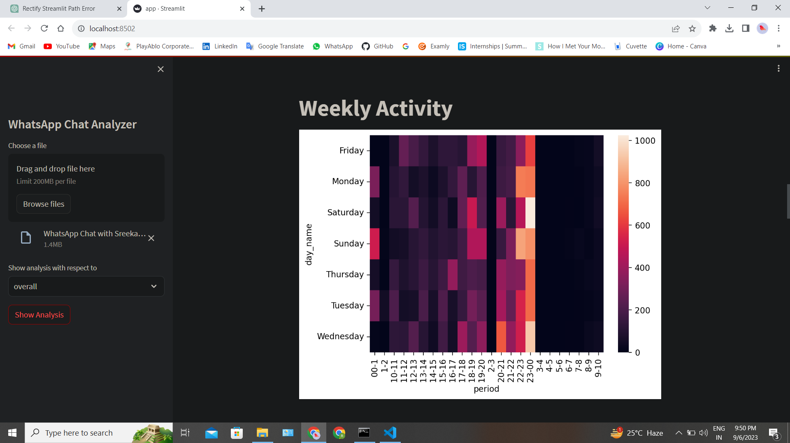

Slide 37
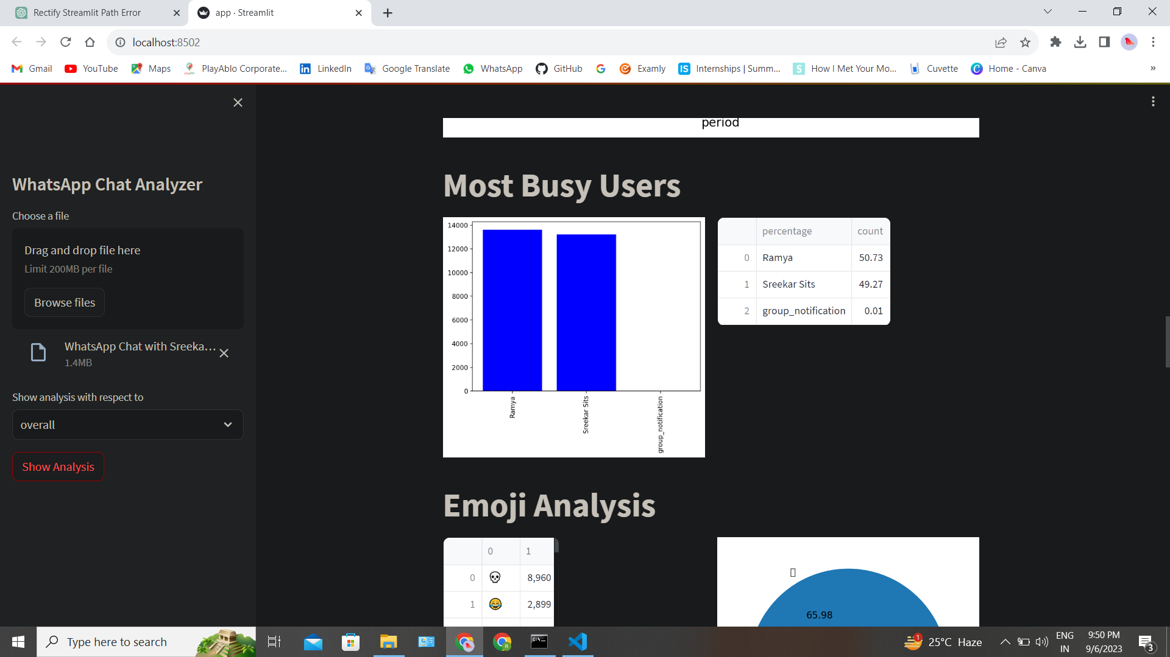

Slide 38
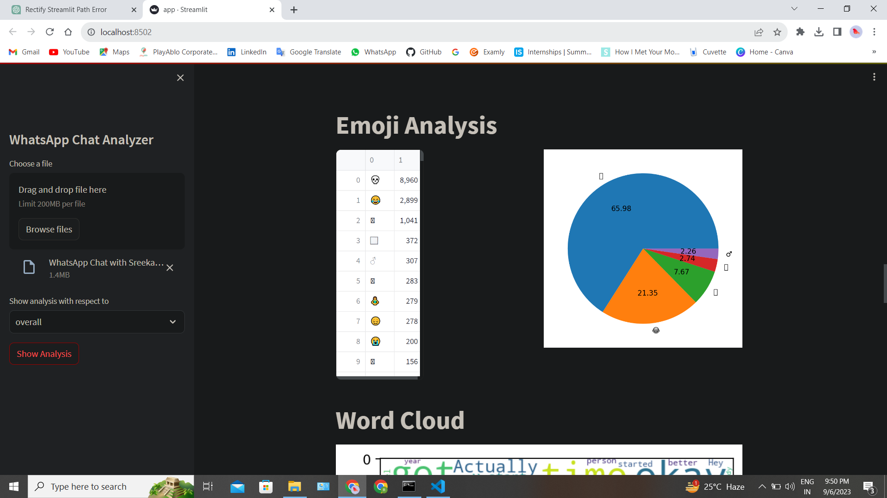

Slide 39
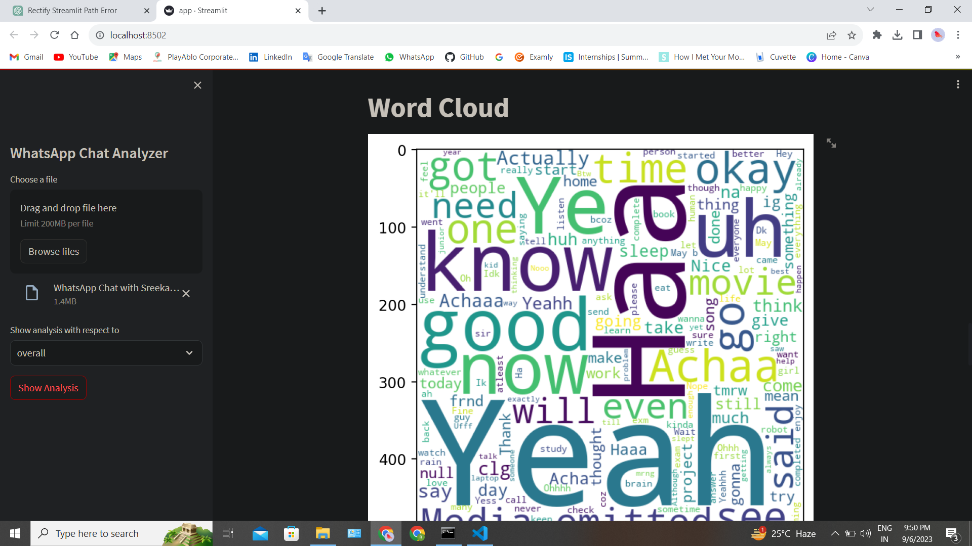

Slide 40
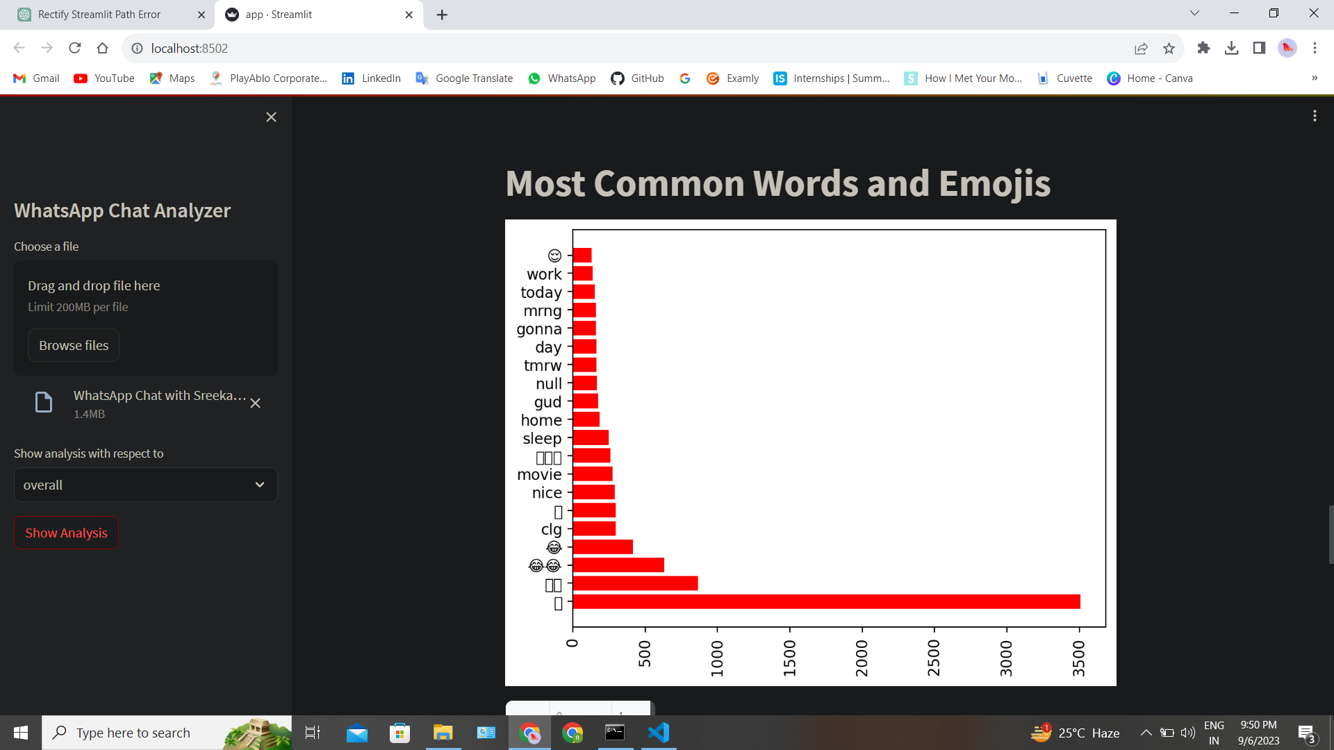

Slide 41
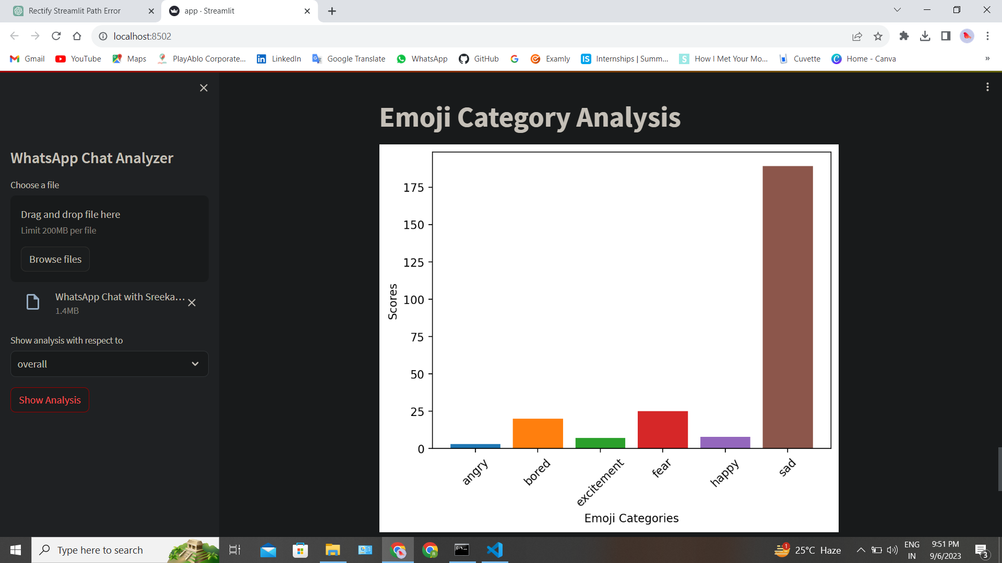

Slide 42
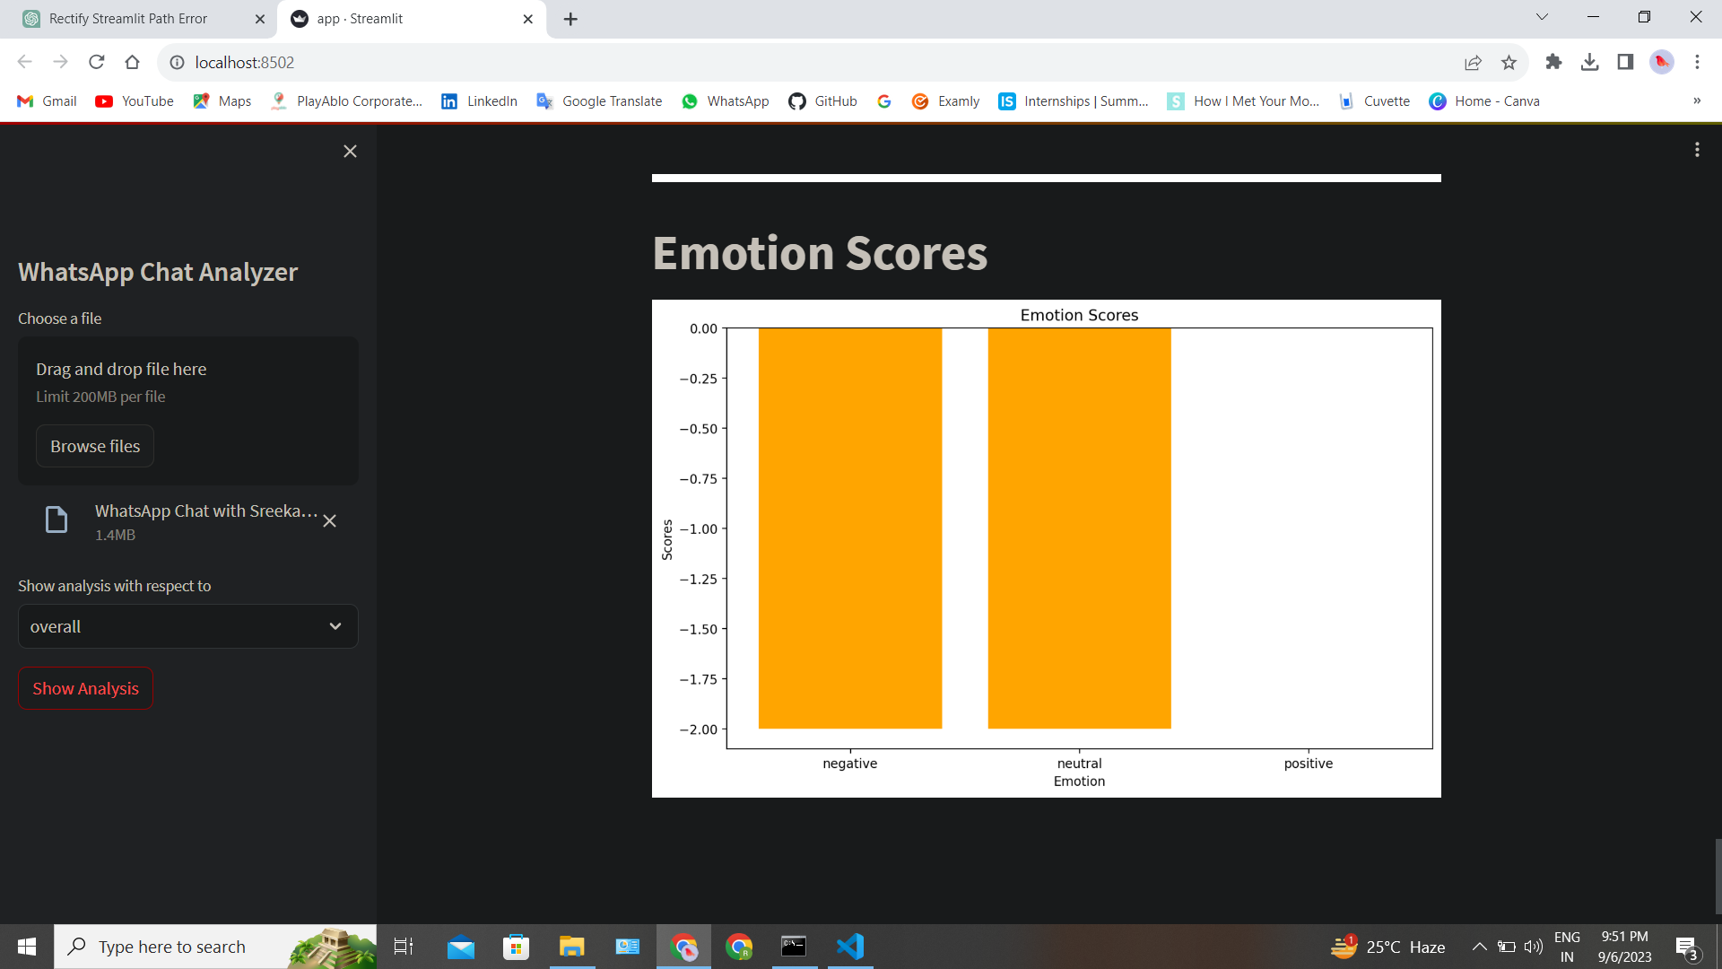

Slide 43
RESULTS AND DISCUSSION
This project is created in python using Streamlit.
Working of project:
User go to sidebar and click on browse file .
Select WhatsApp chat text file and import it for analysis .
User have choice for overall analysis or specific user analysis from whole group.
After selecting user, User click on show analysis button to analyze imported file.
It shows analysis of imported WhatsApp text file.
User can see Total messages, words, media and link shared in the group.
7. then monthly and daily timeline for the message is shown using line charts.

Slide 44
8. Activity Map in which most busy month and day is shown by the bar charts.
9. then weekly activity map which shows hourly activity of users with corresponding day using heat map.
10. Top five busy users in group using graph and list of users with percentage of use.
11.WordCloud shows an interesting visualization of most common words.
12. Top twenty most common word represented by using bar chart.
13. List of Emoji’s with number of times it is used.
14. Emoji and sentiment analysis of chat
15. Pie chart which shows top five emoji’s percentage of use.
This is the result of project and how project is working

Slide 45
CONCLUSION
The major objective that has been decided in the initial phase of the requirement analysis is achieved successfully. After the implementation, the system provides reliable results. The system is totally menu and user friendly, which makes it easy for the users even with limited knowledge of computer environment to operate the developed system. The system avoids the drawbacks of the existing manual system and the validation facility of the system totally eliminates the chances of wrong data entry. It has following features:
• User friendly.
• Time saving.
• Runs on any devices.
• Analyzes any WhatsApp imported file.
• Accuracy.
• Reliability.
• Easy to use.

Slide 46
FUTURE SCOPE
The future scope of a WhatsApp chat analysis project is promising, with opportunities for further enhancement and expansion. Some potential future directions and scope for improvement include:
Real-time Analysis
Customizable Dashboards
Social Network Integration
Chat Summarization
User Engagement Insights
Predictive Analysis
Data Visualization Enhancements
Data Export
The future scope of a WhatsApp chat analysis project largely depends on the evolving needs of users and advancements in natural language processing and data analysis techniques. By addressing these opportunities, the project can continue to provide valuable insights into chat data and user interactions.

Slide 47
REFERENCES
[1] D.Radha, R. Jayaparvathy, D. Yamini, “Analysis on Social Media Addiction using Data Mining Technique”, International Journal of Computer Applications (0975 – 8887).
[2] Python for Everybody: Exploring Data in Python 3 by Dr. Charles Russell Severance.
[3] Storytelling with Data: A Data Visualization Guide for Business Professionals by Cole Nussbaumer Knaflic

Slide 48
THANK YOU..

